Slide 1
How to Apply on HEPC Portal

Slide 2
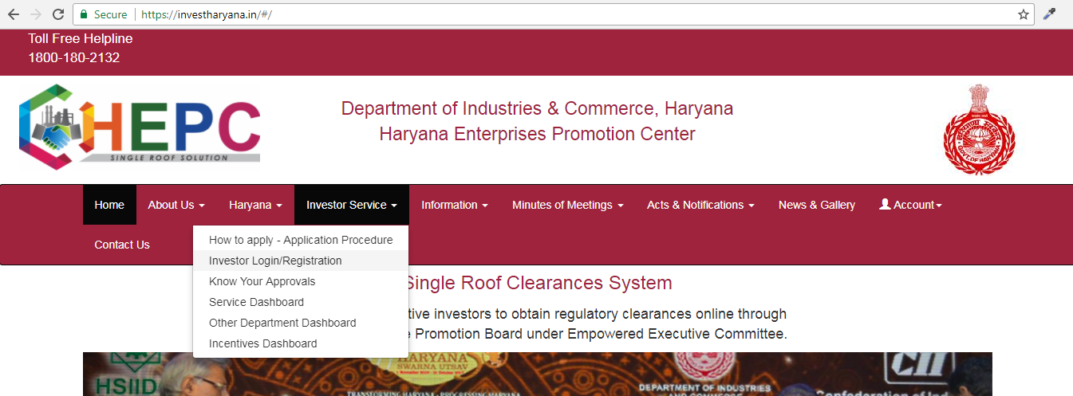
Click here for HEPC Registration

Slide 3
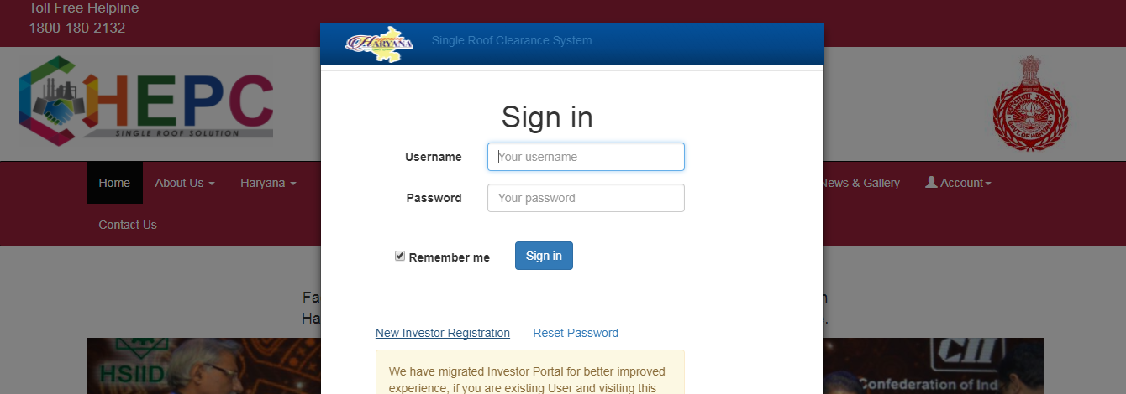
Click here for new registration

Slide 4
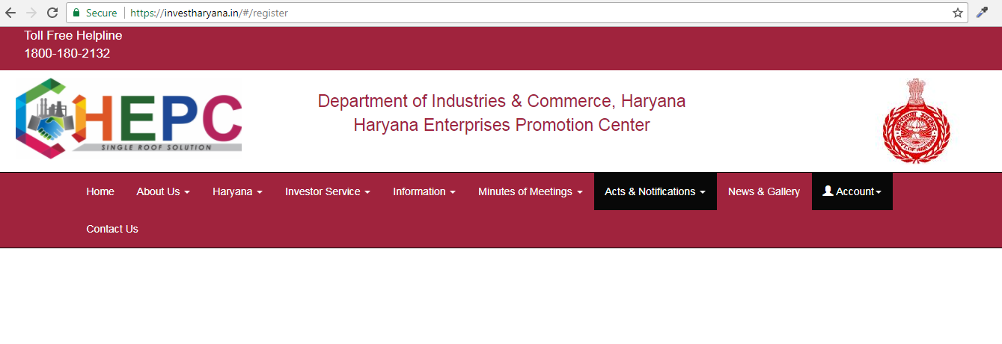
HEPC Registration Page Url

Slide 5
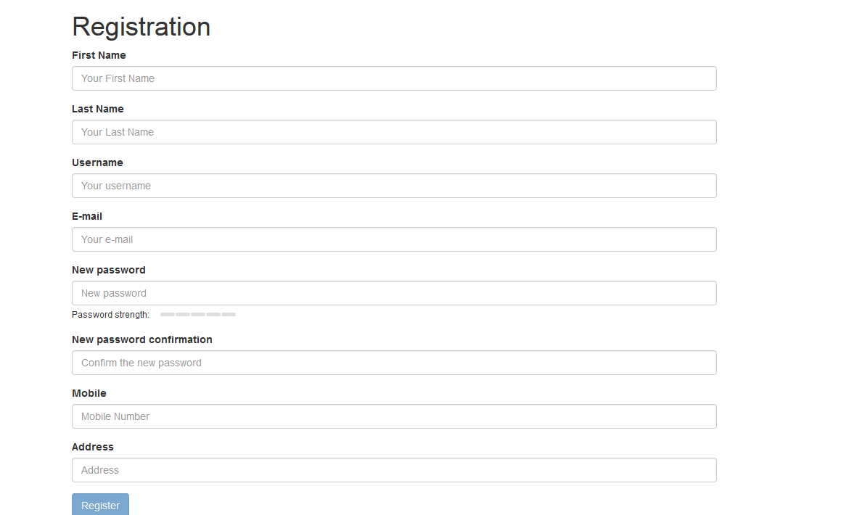
Fill This Registration Form

Slide 6
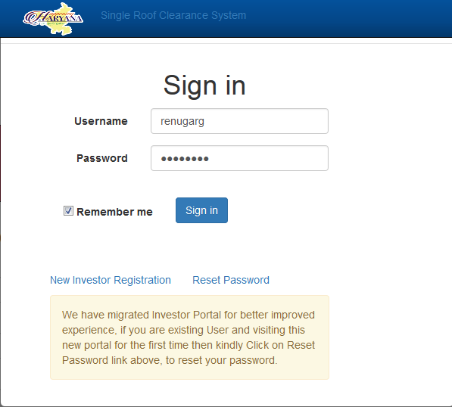
Enter Username here
Enter Password here
Click here to login

Slide 7
Click here to add new project

Slide 8
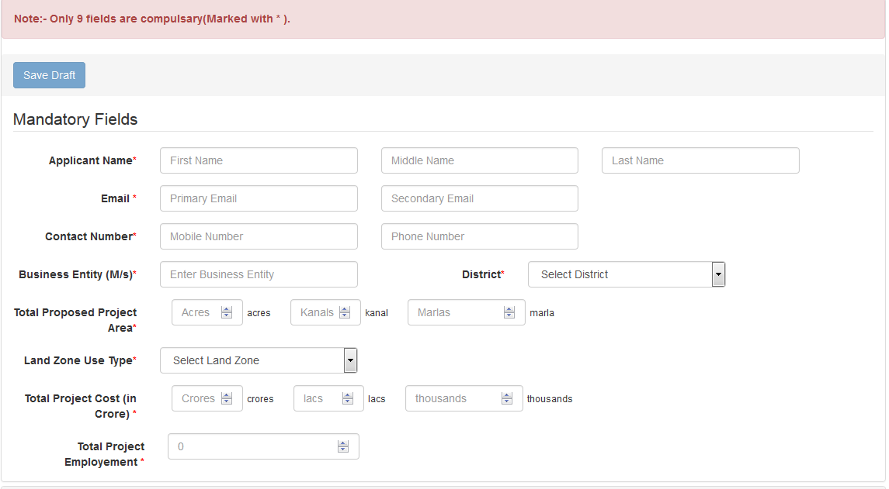
Fill this form for create a new project

Slide 9
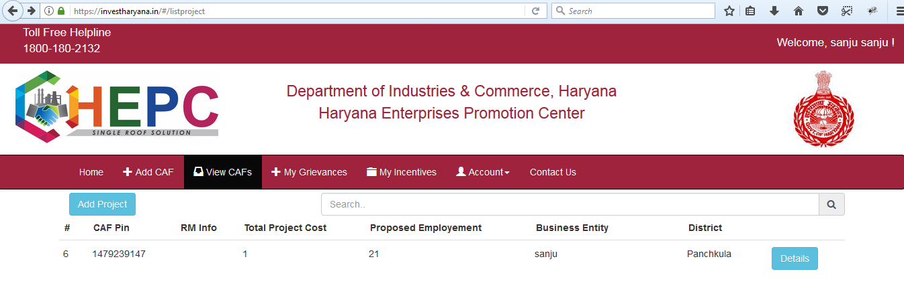
Display Project Information after creating a new project
Click here to see project detail

Slide 10
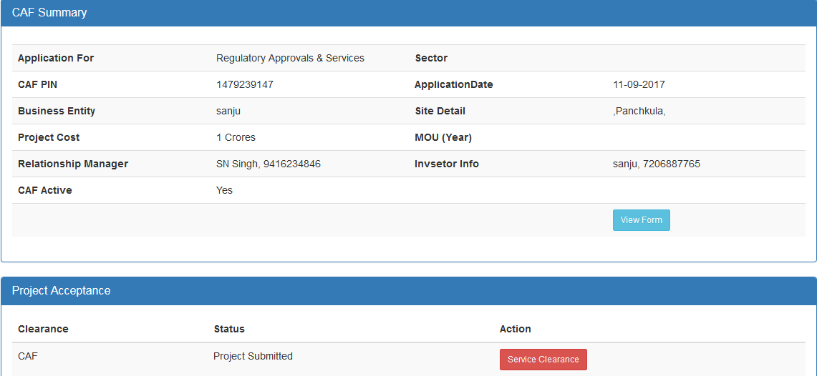
Click on this button for availing electricity service

Slide 11
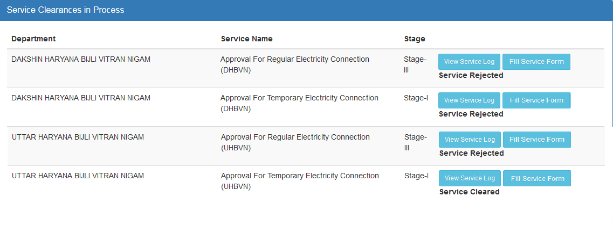
Click here to fill electricity connection form

Slide 12
Thank-You

